Slide 1
Conversion from infix to prefix

Slide 2
Infix to prefix
Step 1: Reverse the infix expression i.e A+B*C will become C*B+A. Note while reversing each ‘(‘ will become ‘)’ and each ‘)’ becomes ‘(‘.
Step 2: Obtain the postfix expression of the modified expression i.e CB*A+. (Refer infix to postfix steps)
Step 3: Reverse the postfix expression. Hence in our example prefix is +A*BC.

Slide 3
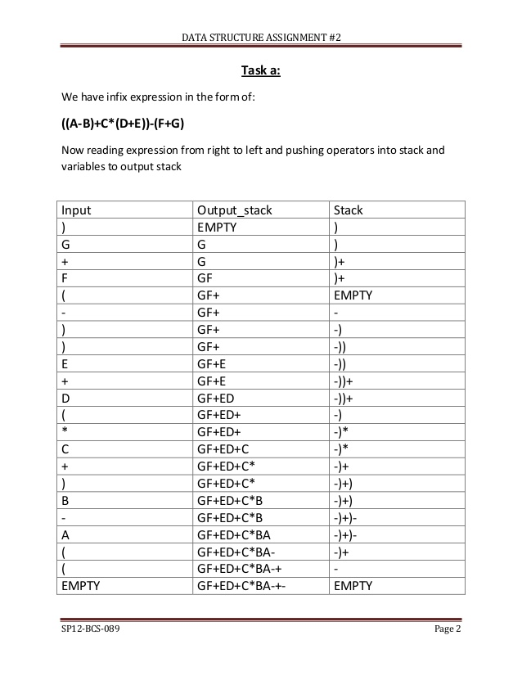

Slide 4
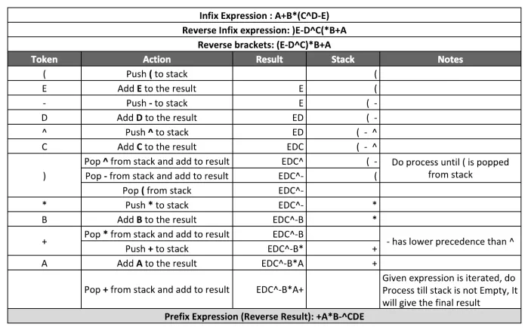

Slide 5
Stack Implementation using Array
#include<iostream.h>
#include<conio.h>
#include<process.h>
enum Boolean{FALSE,TRUE};
typedef char elt;
class stack
{ int top;
elt a[10];
int maxsize;
public:
stack(int size);
Boolean Isfull();
Boolean Isempty();
void push(elt x);
elt pop();
void display();
elt peek(){ if (top!=-1)
return a[top]; else return -1;}
};

Slide 6
stack::stack(int size)
{
maxsize=size;top=-1;
}
Boolean Stack::Isfull()
{
if(top==maxsize-1)
return TRUE;
return FALSE;
}
Boolean Stack::Isempty()
{ if(top==-1)
return TRUE;
return FALSE;
}

Slide 7
void stack::push(elt x)
{ if(Isfull())
cout<<"Stack is full \n";
else
a[++top]=x;
}
elt stack::pop()
{
if(Isempty())
{cout<<"stack is empty\n"; return -1;}
else{
cout<<"deleted element is"<<(a[top]);
return (a[top--])
}}
void stack::display()
{ if(Isempty())
cout<<"stack is empty\n";
else
for(int i=top;i>-1;i--)
cout<<a[i];
}

Slide 8
int isOperator(char input)
{
switch (input) {
case '+':
return 1;
case '-':
return 1;
case '*':
return 1;
case '^':
return 1;
case '%':
return 1;
case '/':
return 1;
case '(':
return 1;
}
return 0;
}
int isOperand(char input)
{
if (input >= 65 && input <= 90
|| input >= 97 && input <= 122)
return 1;
return 0;
}
int Prec(char input)
{
switch (input) {
case '+':
case '-':
return 2;
case '*':
case '%':
case '/':
return 4;
case '^':
return 5;
default:
return 0;
}
}

Slide 9
void infixtoprefix(char *infix)
{int i=0; Stack s(10); int k=0;
int n=strlen(infix);
char prefix[n];
convert(infix);// reverses and changes ‘(‘
for(i=0; infix[i]!=‘\0’;i++) {
if(isOperand(infix[i]))
prefix[k++]=infix[i];
else if (infix[i]==‘(‘) s.push(infix[i]);
else if(infix[i]==‘)’) {
while(s.peek()!=‘(‘) prefix[k++]=s.pop();
s.pop();}
else if isOperator(infix[i])
{
while((prec(s.peek()) >=prec(infix[i]))
prefix[k++]=s.pop();
s.push(infix[i]);
}
}
while(s.peek()!=-1) prefix[k++]=s.pop();
prefix[k]=‘\0’;
convert(prefix); //finally reverse
puts(prefix); }

Slide 10
Main program
void main(){
char infix[20];
cout<<“Enter infix expression”;
gets(infix);
Infixtoprefix(infix);
}
void convert(char *str){
strrev(str); int l=strlen(str);
for (int i = 0; i < l; i++) {
if (infix[i] == '(') {
infix[i] = ')';
i++;
}
else if (infix[i] == ')') {
infix[i] = '(';
i++;
}
}

Slide 11
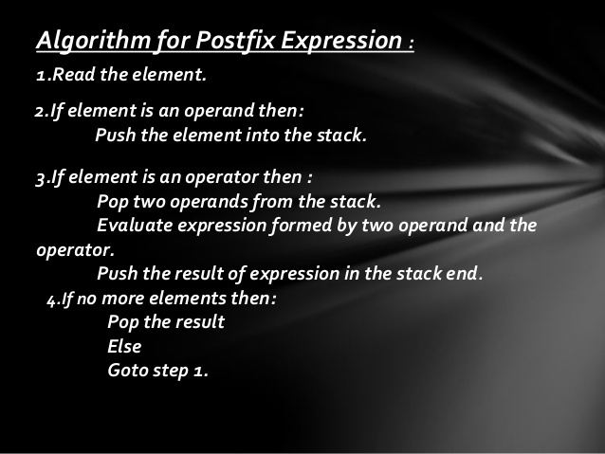
Postfix expression evaluation

Slide 12
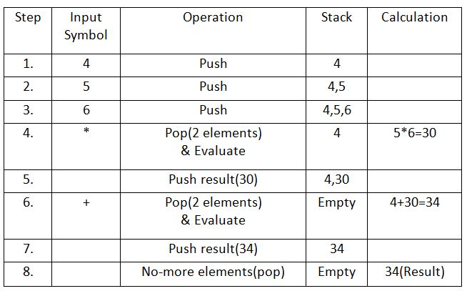

Slide 13
#include<iostream>
#include<cmath>
#include<stack>
using namespace std;
float scanNum(char ch) {
int value;
value = ch;
return float(value-'0'); //return float from character
}
int isOperator(char ch) {
if(ch == '+'|| ch == '-'|| ch == '*'|| ch == '/' || ch == '^')
return 1; //character is an operator
return -1; //not an operator
}
int isOperand(char ch) {
if(ch >= '0' && ch <= '9')
return 1; //character is an operand
return -1; //not an operand
}
float operation(int a, int b, char op) {
//Perform operation
if(op == '+')
return a+b
else if(op == '-')
return a-b;
else if(op == '*')
return a*b;
else if(op == '/')
return a/b;
else if(op == '^')
return pow(a,b); //find a^b
else
return INT_MIN; //return negative infinity
}

Slide 14
float postfixEval(char * postfix) {
int a, b; int i;
stack<float> stk;
for(i=0;postfix[i]!=‘\0’;i++) {
//read elements and perform postfix //evaluation
if(isOperator(postfix[i]) != -1) {
b=stk.pop();
a = stk.pop();
stk.push(operation(a, b, postfix[i]);
}else if(isOperand(postfix[i]) > 0) {
stk.push(scanNum(postfix[i]));
}
}
return stk.pop();
}
main() {
char post[30] = "53+62/*35*+";
cout << "The result is: "<<postfixEval(post);
}

Slide 15
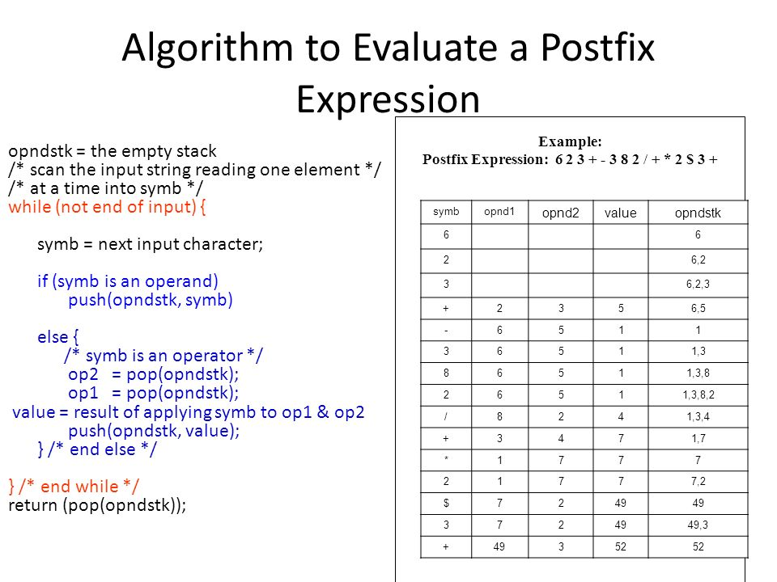

Slide 16
Evaluation of prefix expression
EVALUATE_PREFIX(STRING)
Step 1: Put a pointer P at the end of the string
Step 2: If character at P is an operand push it to Stack
Step 3: If the character at P is an operator pop two
elements from the Stack. Operate on these elements
according to the operator, and push the result
back to the Stack
Step 4: Decrement P by 1 and go to Step 2 as long as there
are characters left to be scanned in the expression.
Step 5: The Result is stored at the top of the Stack,
return it
Step 6: End

Slide 17
Expression: +9*26
Character | Stack | Explanation
Scanned | (Front to |
| Back) |
-------------------------------------------
6 6 6 is an operand,
push to Stack
2 6 2 2 is an operand,
push to Stack
* 12 (6*2) * is an operator,
pop 6 and 2, multiply
them and push result
to Stack
9 12 9 9 is an operand, push
to Stack
+ 21 (12+9) + is an operator, pop
12 and 9 add them and
push result to Stack
Result: 21

Slide 18
Convert postfix to infix algorithm
Iterate the given expression from left to right, one character at a time
If a character is operand, push it to stack.
If a character is an operator,
pop operand from the stack, say it’s s1.
pop operand from the stack, say it’s s2.
perform (s2 operator s1) and push it to stack.
Once the expression iteration is completed, initialize the result string and pop out from the stack and add it to the result.
Return the result.

Slide 19
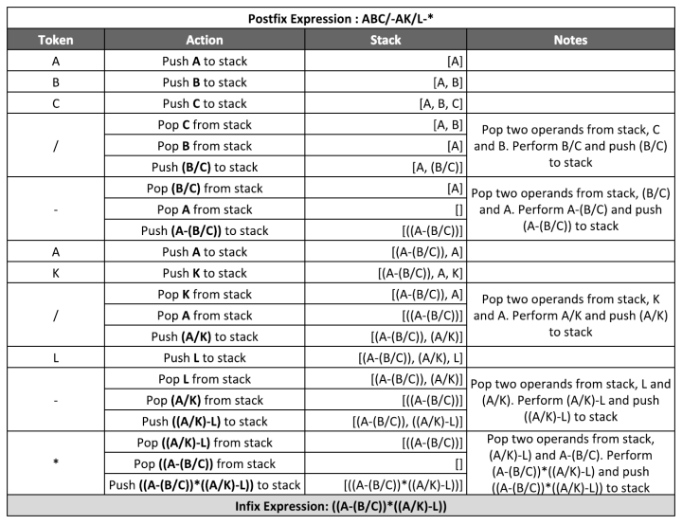

Slide 20
Prefix to infix conversion
Algorithm for Prefix to Infix:
Read the Prefix expression in reverse order (from right to left)
If the symbol is an operand, then push it onto the Stack
If the symbol is an operator, then pop two operands from the Stack Create a string by concatenating the two operands and the operator between them. string = (operand1 + operator + operand2) And push the resultant string back to Stack
Repeat the above steps until end of Prefix expression.

Slide 21
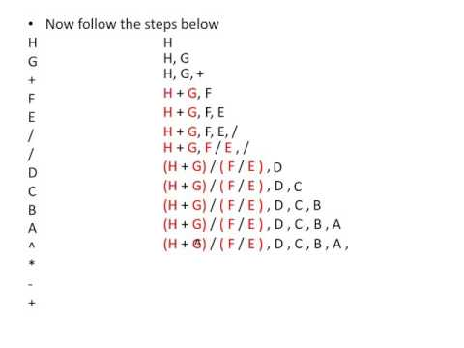

Slide 22
prefix to postfix conversion
Algorithm for Prefix to Postfix:
Read the Prefix expression in reverse order (from right to left)
If the symbol is an operand, then push it onto the Stack
If the symbol is an operator, then pop two operands from the Stack Create a string by concatenating the two operands and the operator after them. string = operand1 + operand2 + operator And push the resultant string back to Stack
Repeat the above steps until end of Prefix expression.

Slide 23
Algorithm for Postfix to Prefix:
Read the Postfix expression from left to right
If the symbol is an operand, then push it onto the Stack
If the symbol is an operator, then pop two operands from the Stack
Create a string by concatenating the two operands and the operator before them.
string = operator + operand2 + operand1
And push the resultant string back to Stack
Repeat the above steps until end of Postfix expression.

Slide 24
